Slide 1
CSci 3081W: Program Design and Development
Lecture 11 – Observer Pattern

Slide 2
Behavioral Design Patterns
Behavioral design patterns are concerned with algorithms and the assignment of responsibilities between objects.

Slide 3
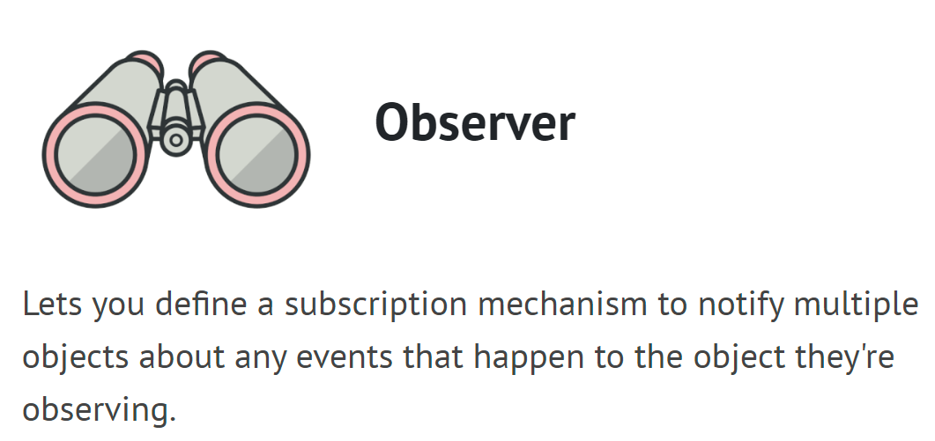
Behavioral Design Patterns

Slide 4
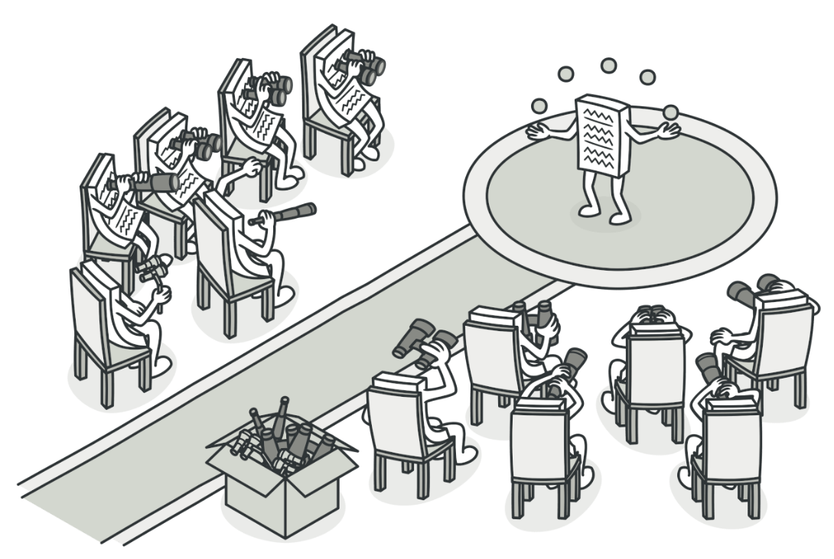
Observer Pattern
Observer is a behavioral design pattern that lets you define a subscription mechanism to notify multiple objects about any events that happen to the object they’re observing.

Slide 5
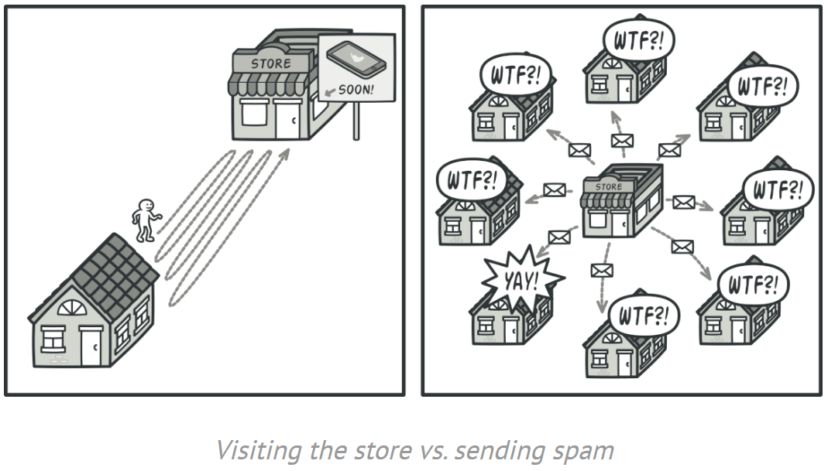
Problem

Slide 6
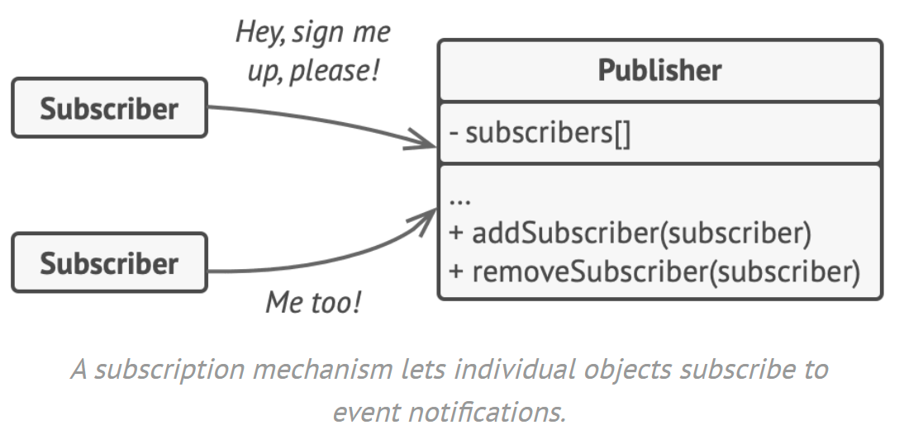
Solution

Slide 7
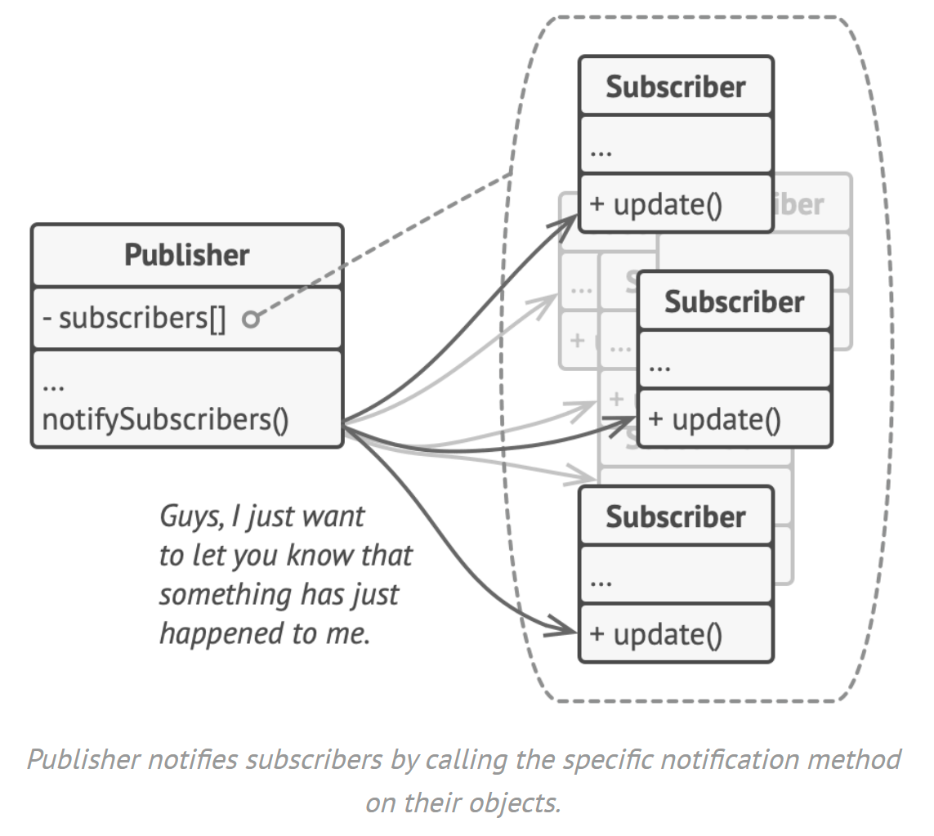
Solution

Slide 8
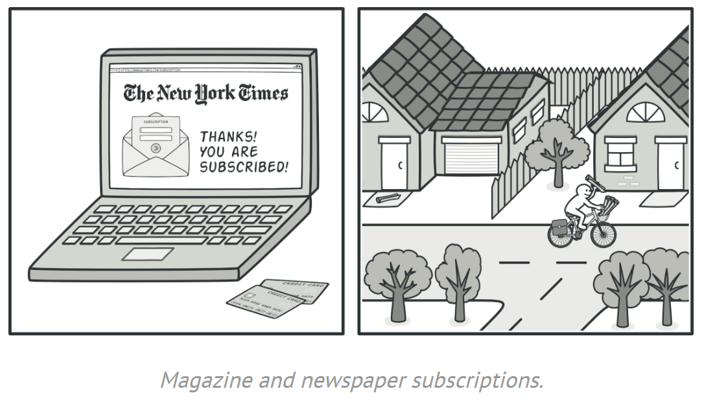
Examples

Slide 9
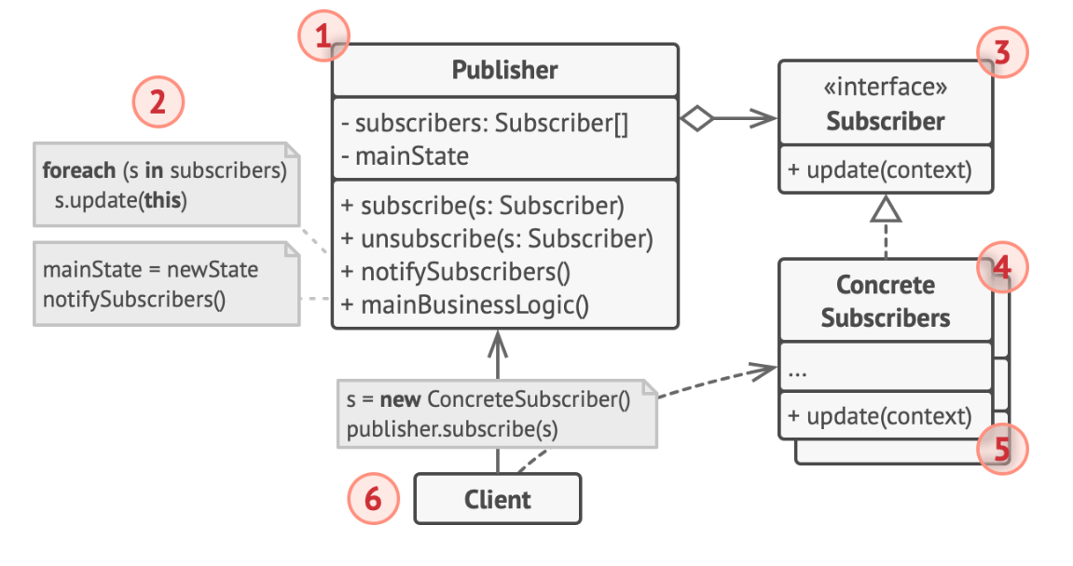
UML Class Diagram
1. The Publisher issues events of interest to other objects. These events occur when the publisher changes its state or executes some behaviors.

Slide 10
UML Class Diagram
2. When a new event happens, the publisher goes over the subscription list and calls the notification method declared in the subscriber interface on each subscriber object.

Slide 11
UML Class Diagram
3. In most cases, the Subscriber consists of a single update method. The method may have several parameters that let the publisher pass some event details along with the update.

Slide 12
UML Class Diagram
4. Concrete Subscribers perform some actions in response to notifications issued by the publisher.

Slide 13
UML Class Diagram
5. Usually, subscribers need some contextual information to handle the update correctly. Publishers often pass some context data as arguments of the notification method. The publisher can pass itself as an argument, letting subscriber fetch any required data directly.

Slide 14
UML Class Diagram
6. The Client creates publisher and subscriber objects separately and then registers subscribers for publisher updates.

Slide 15
Applicability
When changes to the state of one object may require changing other objects, and the actual set of objects is unknown beforehand or changes dynamically.
When some objects in your app must observe others, but only for a limited time or in specific cases.
Anytime you see subscribe/unsubscribe or subscriptions mentioned, think of the observer pattern immediately as your solution

Slide 16
The big pros
O from SOLID
Can subscribe/unsubscribe during runtime
Instead of using a vector to keep track of the subscribers, you can use some other data structure such that subscribers are notified in a certain order

Slide 17
Most similar design patterns to observer
Chain of responsibility – keeps passing a request down a chain until one of the links receives it
Command – unidirectional connections between senders and receivers
Mediator – no connections between senders and receivers directly, all communication done indirectly via mediator object
Observer – subscribe/unsubscribe

Slide 18
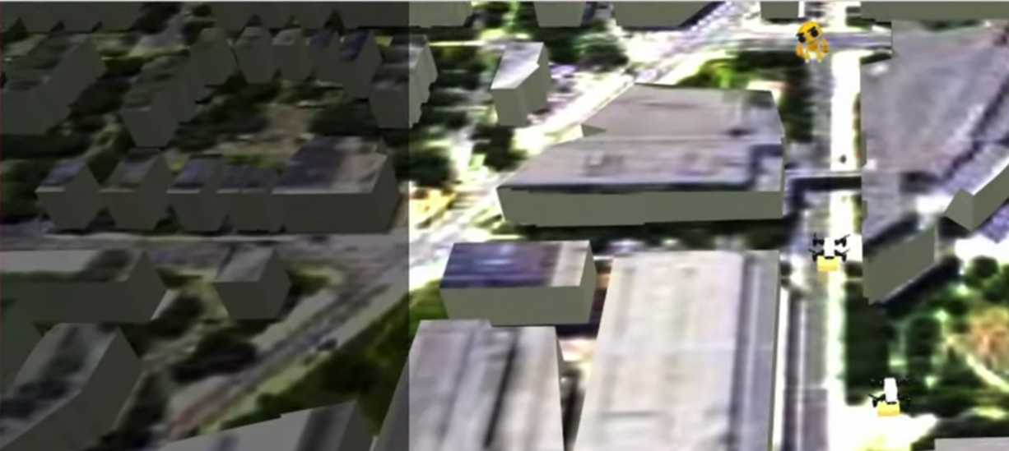

Slide 19
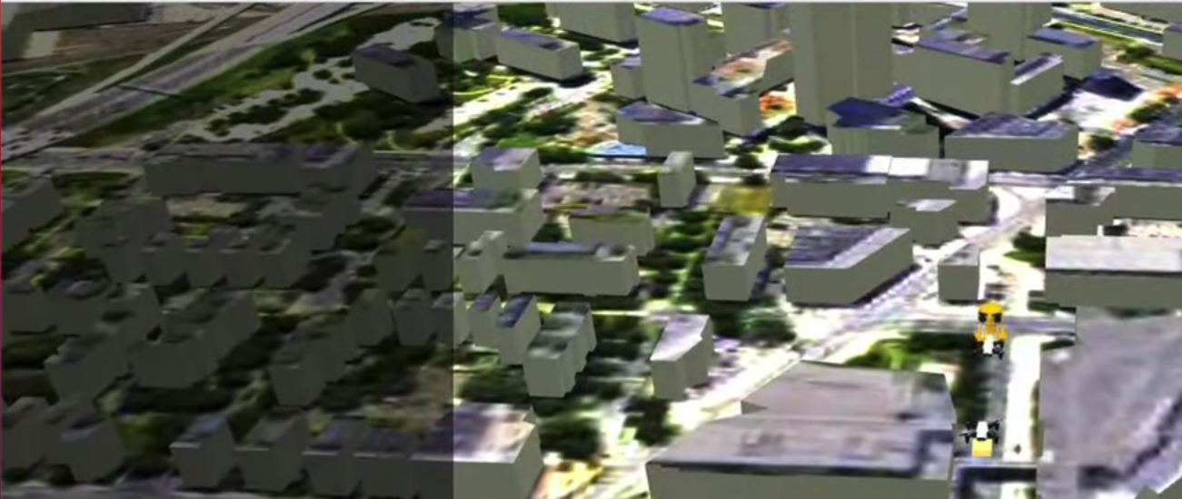
Drone #1 has delivered Package #1 to Customer #1

Slide 20
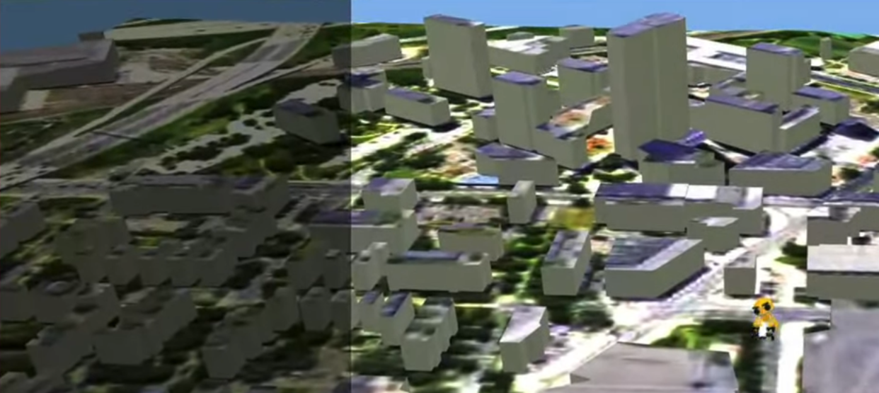
Drone #1 has delivered Package #1 to Customer #1 Drone #2 has delivered Package #2 to Customer #1

Slide 21
Code Examples

Slide 22
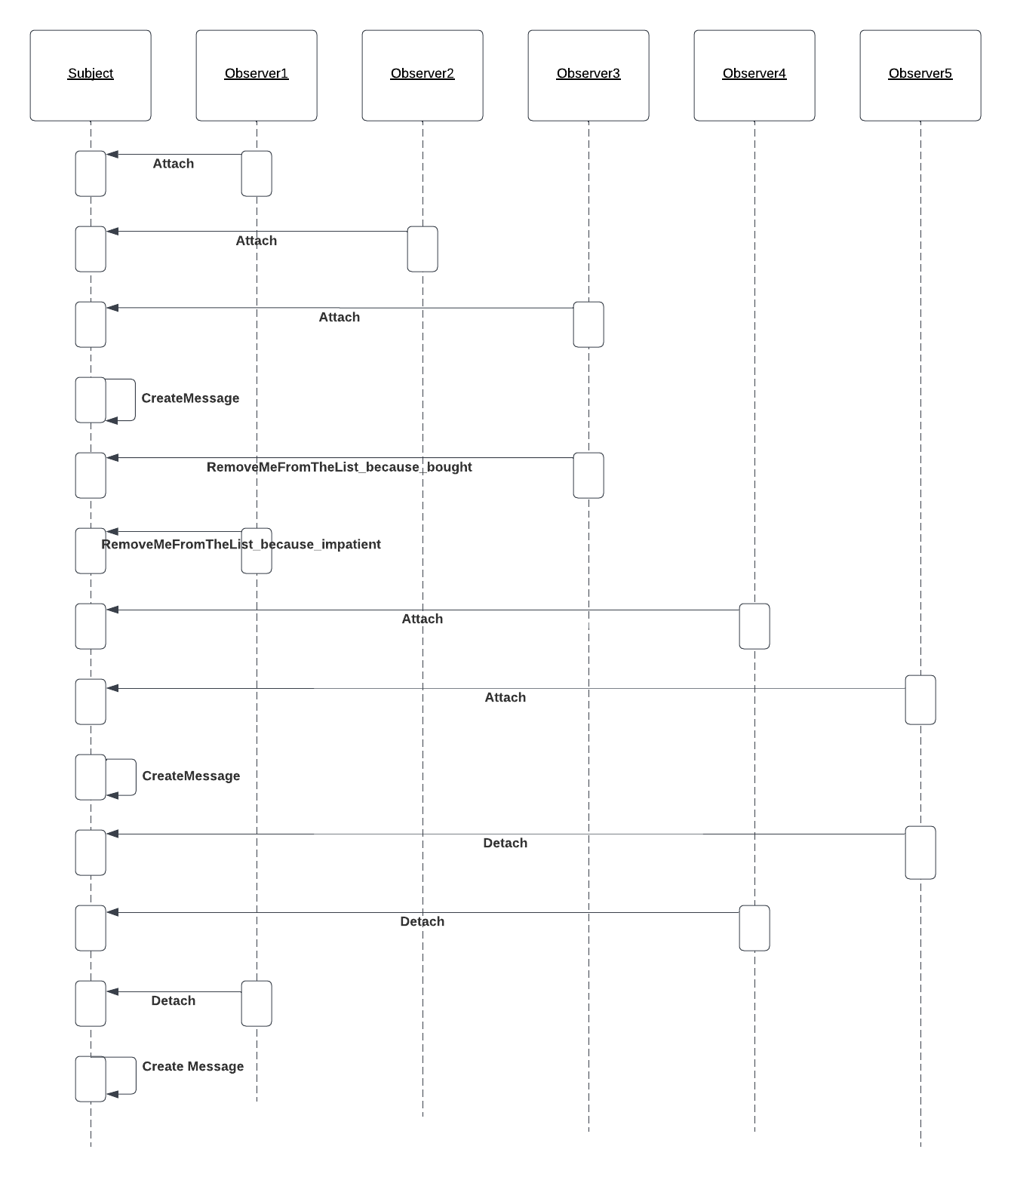
New UML Diagram
time
Sequence Diagram
Shows process interactions in sequence (by time)

Slide 23
HW4 Extension Demos

